Slide 1
Solving Linear Equations

Slide 2
Recap
We have established the importance and usefulness of matrix theory and linear algebra in data sciences
Concepts covered previously
Data representation using matrices
Identifying linear relationships (if any) amongst attributes
How do we establish these linear relationships?
Using null space
In order to calculate null space, we should be able to solve matrix equations
We will now focus on extracting solutions for matrix equations

Slide 3
Solving matrix equations

Slide 4
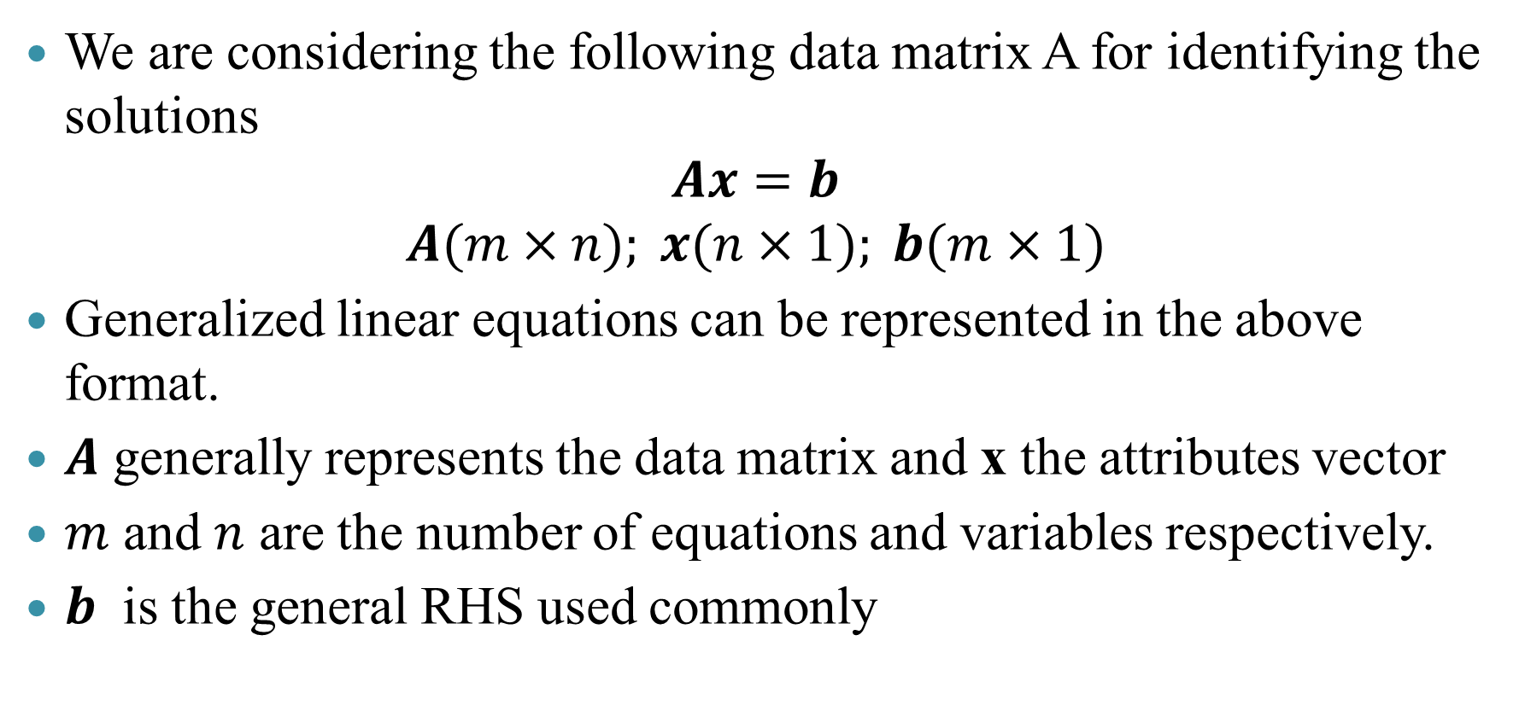
Preliminaries
We are considering the following data matrix A for identifying the solutions
$$Ax=b$$
$$A(m×n); x(n×1); b(m×1)$$
Generalized linear equations can be represented in the above format.
$A$ generally represents the data matrix and x the attributes vector
$m$ and $n$ are the number of equations and variables respectively.
$b$ is the general RHS used commonly

Slide 5
Categorization
$$m=n$$
𝑚=𝑛
Data samples available equal to the number of attributes
Easiest case to solve
$$m>n$$
𝑚>𝑛
More data samples available than the number of attributes
Usually, no unique solutions
$$m<n$$
𝑚<𝑛
Lesser data samples available than the number of attributes
Usually, multiple solutions
We look into these cases independently

Slide 6

Full row and column rank: Concepts
Consider a matrix data matrix $A (m×n)$
Full Row Rank
When all the rows of the matrix are linearly independent
Data sampling does not present a linear relationship – samples are independent
Full Column Rank
When all the columns of the matrix are linearly independent
Attributes are linearly independent
When $A$ is such that $m=n$ then full row rank and full column rank are equivalent

Slide 7

Case $1$: $m=n$
Matrix equations with $m=n$
Matrix equations with 𝑚=𝑛
$A$ is full rank and
$$|A|≠0$$
𝑨 is full rank and
|𝐴|≠0
$${x=A}^{−1}b$$
Unique Solution
〖𝑥=𝐴〗^(−1) 𝑏
Unique Solution
$A$ is not full rank
𝐴 is not full rank
Consistent ($∞$Solutions)
Consistent (∞ Solutions)
Inconsistent
(No Solution)

Slide 8
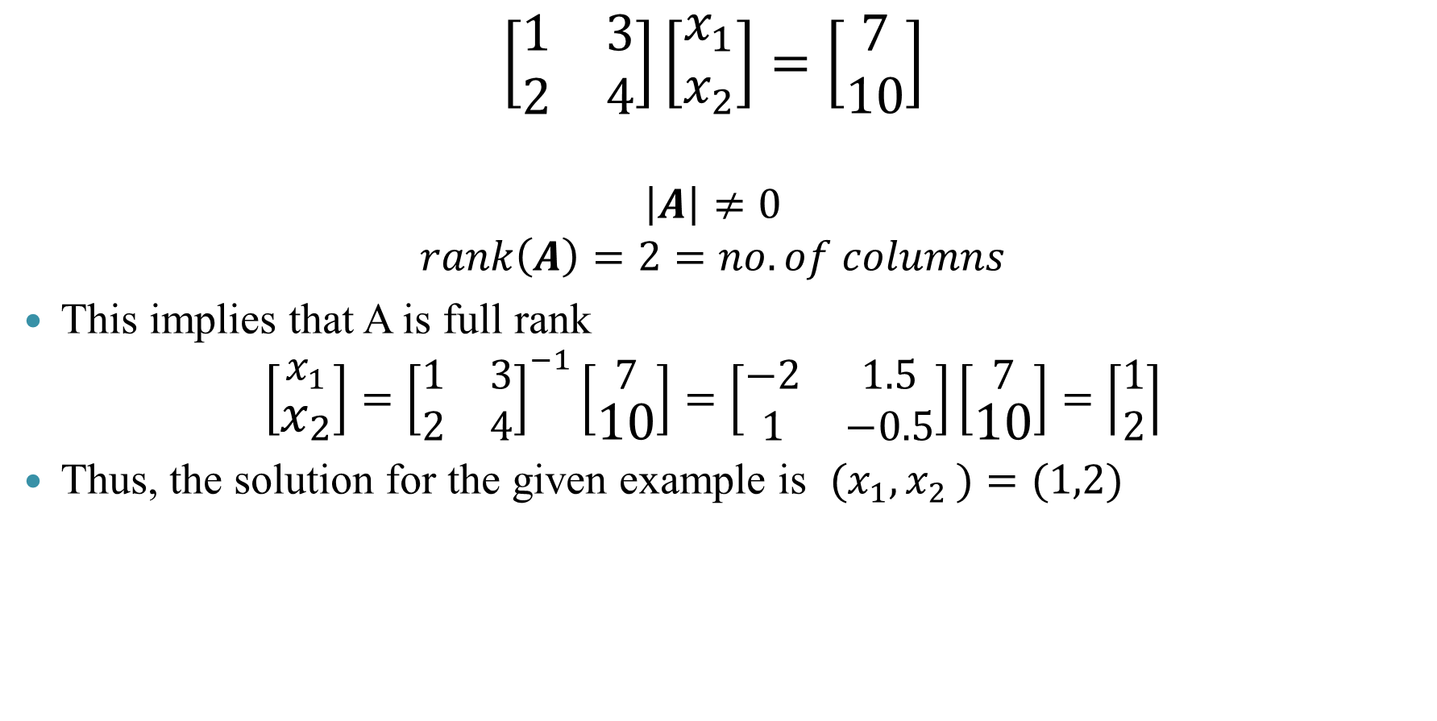

Case $1$: Example $1.1$
$$\left[\begin{matrix}1 & 3 \\ 2 & 4\end{matrix}\right]\left[\begin{aligned}x_{1} \\ x_{2}\end{aligned}\right]=\left[\begin{aligned}7 \\ 10\end{aligned}\right]$$
$$\left|A\right|≠0$$
$$rank\left(A\right)=2=no. of columns$$
This implies that A is full rank
$$\left[\begin{aligned}x_{1} \\ x_{2}\end{aligned}\right]={\left[\begin{matrix}1 & 3 \\ 2 & 4\end{matrix}\right]}^{−1}\left[\begin{aligned}7 \\ 10\end{aligned}\right]=\left[\begin{matrix}−2 & 1.5 \\ 1 & −0.5\end{matrix}\right]\left[\begin{aligned}7 \\ 10\end{aligned}\right]=\left\lceil \begin{aligned}1 \\ 2\end{aligned}\right\rceil$$
Thus, the solution for the given example is ${(x}_{1}{,x}_{2})=(1,2)$
R Code
A=matrix(c(1,2,3,4),ncol=2, byrow=F)
b=c(7,10)
x=solve(A)%*%b
Console output
> x
[,1]
[1,] 1
[2,] 2

Slide 9
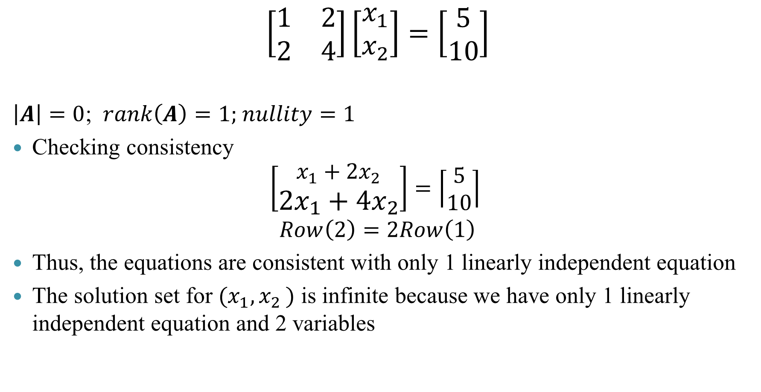

Case $1$: Example $1.2$
$$\left[\begin{matrix}1 & 2 \\ 2 & 4\end{matrix}\right]\left[\begin{aligned}x_{1} \\ x_{2}\end{aligned}\right]=\left[\begin{aligned}5 \\ 10\end{aligned}\right]$$
$\left|A\right|=0$; $rank\left(A\right)=1$; $nullity=1$
Checking consistency
$$\left[\begin{aligned}x_{1}+2x_{2} \\ {2x_{1}+4x}_{2}\end{aligned}\right]=\left\lceil \begin{aligned}5 \\ 10\end{aligned}\right\rceil$$
$$Row\left(2\right)=2Row\left(1\right)$$
Thus, the equations are consistent with only 1 linearly independent equation
The solution set for ${(x}_{1}{,x}_{2})$ is infinite because we have only 1 linearly independent equation and 2 variables
R Code
A=matrix(c(1,2,2,4),ncol=2, byrow=F)
b=c(5,10)
x=solve(A)%*%b
Output
x=solve(A)%*%b
Error in solve.default(A) : Lapack routine dgesv: system is exactly singular: U[2,2] = 0

Slide 10
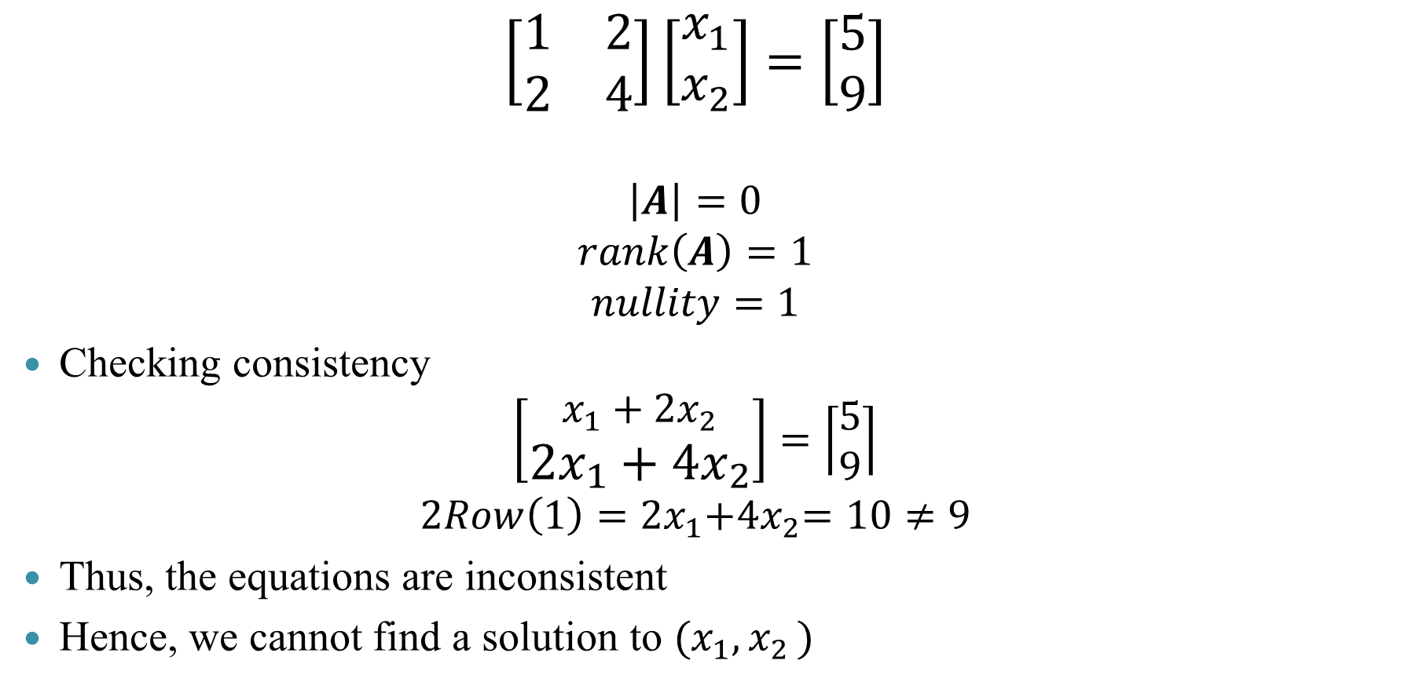

Case $1$: Example $1.3$
$$\left[\begin{matrix}1 & 2 \\ 2 & 4\end{matrix}\right]\left[\begin{aligned}x_{1} \\ x_{2}\end{aligned}\right]=\left[\begin{aligned}5 \\ 9\end{aligned}\right]$$
$$\left|A\right|=0$$
$$rank\left(A\right)=1$$
$$nullity=1$$
Checking consistency
$$\left[\begin{aligned}x_{1}+2x_{2} \\ {2x_{1}+4x}_{2}\end{aligned}\right]=\left\lceil \begin{aligned}5 \\ 9\end{aligned}\right\rceil$$
$${2Row\left(1\right)=2x}_{1}{+4x}_{2}=10≠9$$
Thus, the equations are inconsistent
Hence, we cannot find a solution to ${(x}_{1}{,x}_{2})$
R Code
A=matrix(c(1,2,2,4),ncol=2, byrow=F)
b=c(5,9)
x=solve(A)%*%b
Output
x=solve(A)%*%b
Error in solve.default(A) : Lapack routine dgesv: system is exactly singular: U[2,2] = 0

Slide 11

Case 2: $m>n$
This case addresses the problem of not enough attributes
Since the number of equations is greater than the number of variables, not all equations can be satisfied
It is hence, sometimes termed as a no-solution case
But, we can view the same problem in an optimization perspective to gain some more insights

Slide 12
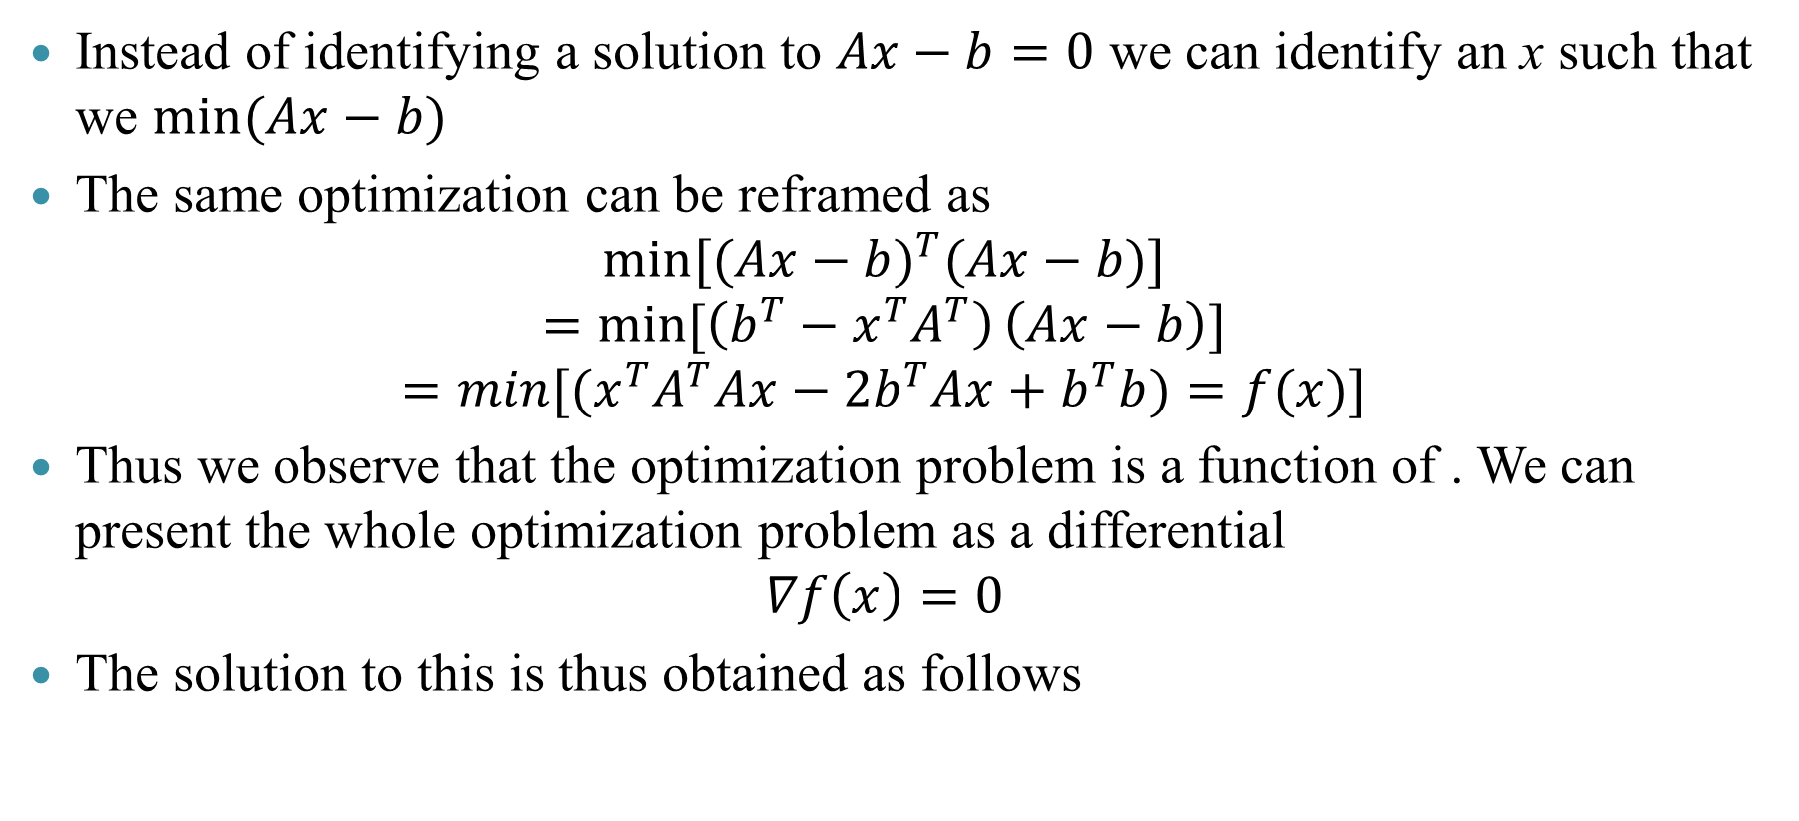
Case 2: An optimization perspective
Instead of identifying a solution to $Ax−b=0$ we can identify an x such that we $\min{(Ax−b)}$
The same optimization can be reframed as
$$\min{{[(Ax−b)}^{T}(Ax−b)}]$$
$$=\min{[\left(b^{T}−x^{T}A^{T}\right)}\left(Ax−b\right)]$$
$$=min[(x^{T}A^{T}Ax−2b^{T}Ax+b^{T}b)=f(x)]$$
Thus we observe that the optimization problem is a function of . We can present the whole optimization problem as a differential
$$∇f\left(x\right)=0$$
The solution to this is thus obtained as follows

Slide 13

Case 2: An optimization perspective
We can identify the solution to the optimization problem by differentiating f
$$2\left(A^{T}A\right)x−2A^{T}b=0$$
$$\left(A^{T}A\right)x=A^{T}b$$
$$x={(A^{T}A)}^{−1}A^{T}b$$
This is the solution we obtain to the second case using optimization concepts

Slide 14
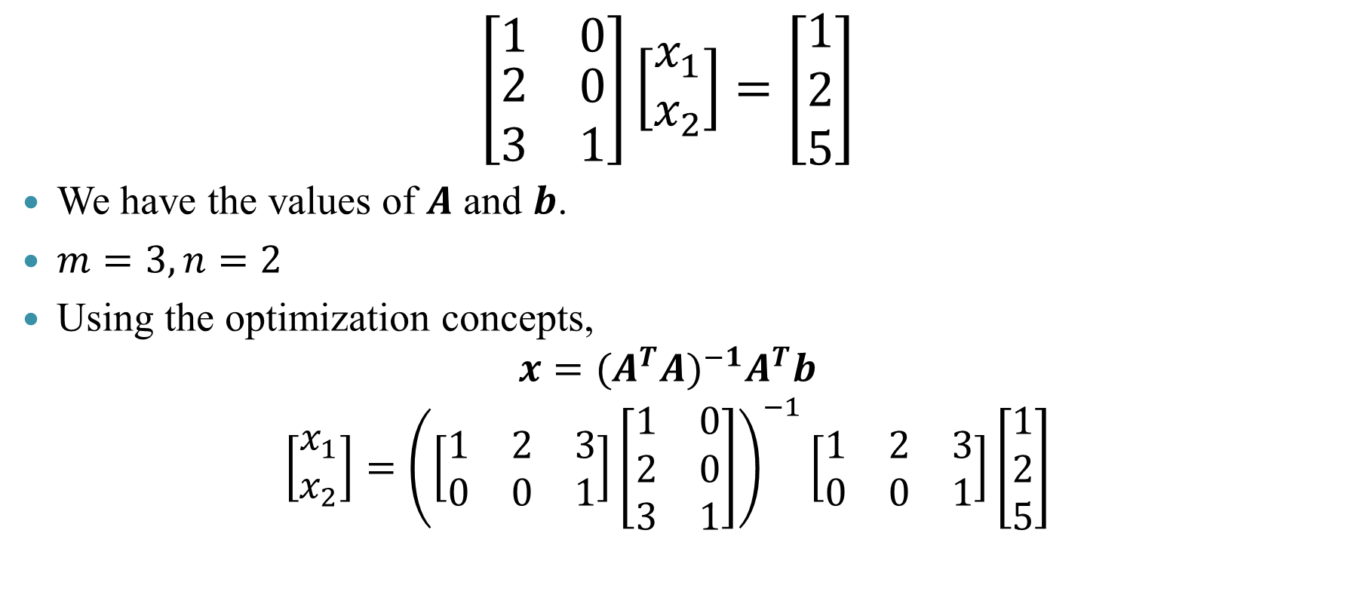
Case 2: Example
$$\left[\begin{matrix}1 & 0 \\ \begin{aligned}2 \\ 3\end{aligned} & \begin{aligned}0 \\ 1\end{aligned}\end{matrix}\right]\left[\begin{aligned}x_{1} \\ x_{2}\end{aligned}\right]=\left[\begin{aligned}1 \\ 2 \\ 5\end{aligned}\right]$$
We have the values of $A$ and $b$.
$m=3,n=2$
Using the optimization concepts,
$$x={(A^{T}A)}^{−1}A^{T}b$$
$$\left[\begin{aligned}x_{1} \\ x_{2}\end{aligned}\right]={\left(\left[\begin{matrix}1 & 2 & 3 \\ 0 & 0 & 1\end{matrix}\right]\left[\begin{matrix}1 & 0 \\ 2 & 0 \\ 3 & 1\end{matrix}\right]\right)}^{−1}\left[\begin{matrix}1 & 2 & 3 \\ 0 & 0 & 1\end{matrix}\right]\left[\begin{aligned}1 \\ 2 \\ 5\end{aligned}\right]$$

Slide 15
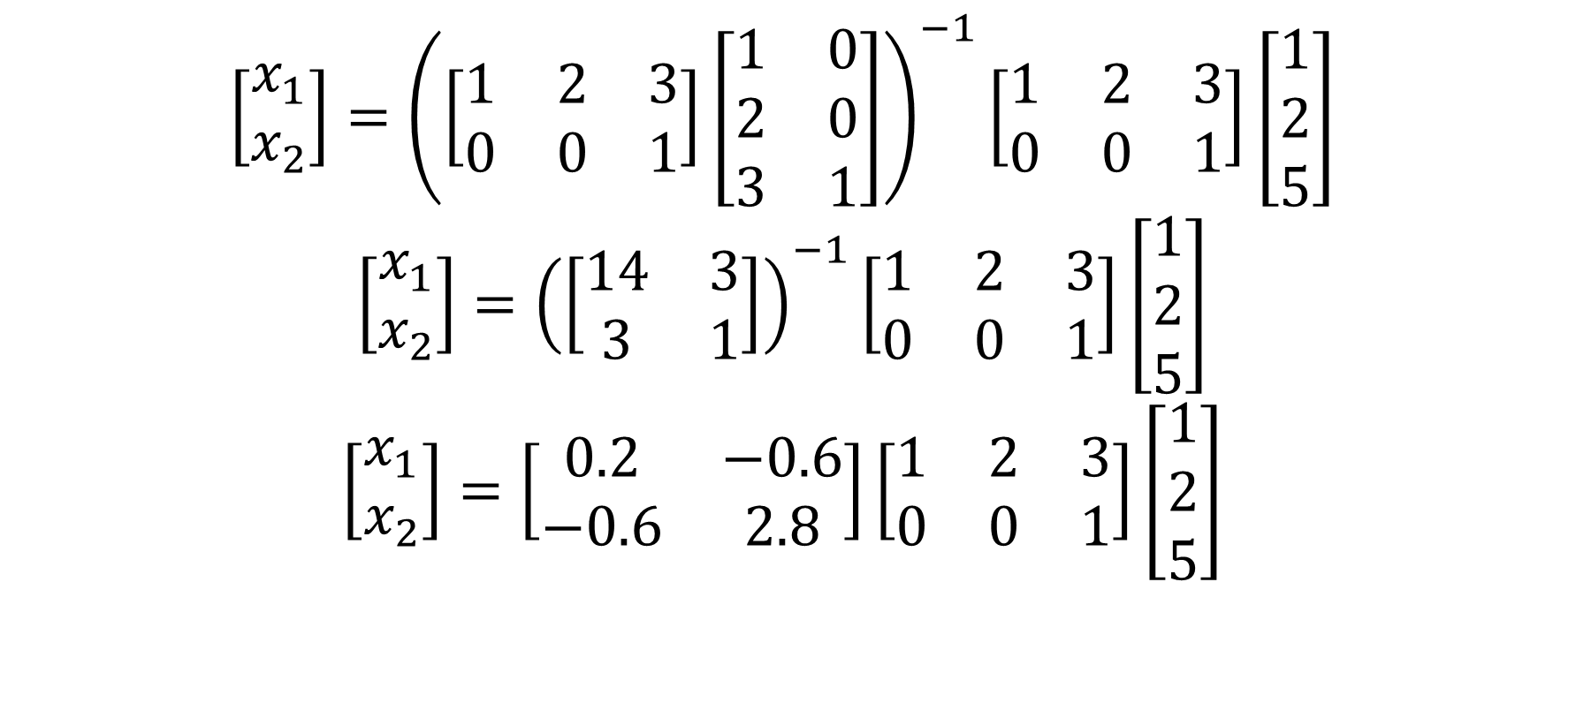
Case 2: Example continued
$$\left[\begin{aligned}x_{1} \\ x_{2}\end{aligned}\right]={\left(\left[\begin{matrix}1 & 2 & 3 \\ 0 & 0 & 1\end{matrix}\right]\left[\begin{matrix}1 & 0 \\ 2 & 0 \\ 3 & 1\end{matrix}\right]\right)}^{−1}\left[\begin{matrix}1 & 2 & 3 \\ 0 & 0 & 1\end{matrix}\right]\left[\begin{aligned}1 \\ 2 \\ 5\end{aligned}\right]$$
$$\left[\begin{aligned}x_{1} \\ x_{2}\end{aligned}\right]={\left(\left[\begin{matrix}14 & 3 \\ 3 & 1\end{matrix}\right]\right)}^{−1}\left[\begin{matrix}1 & 2 & 3 \\ 0 & 0 & 1\end{matrix}\right]\left[\begin{aligned}1 \\ 2 \\ 5\end{aligned}\right]$$
$$\left[\begin{aligned}x_{1} \\ x_{2}\end{aligned}\right]=\left[\begin{matrix}0.2 & −0.6 \\ −0.6 & 2.8\end{matrix}\right]\left[\begin{matrix}1 & 2 & 3 \\ 0 & 0 & 1\end{matrix}\right]\left[\begin{aligned}1 \\ 2 \\ 5\end{aligned}\right]$$

Slide 16

Case 2: Example continued
$$\left[\begin{aligned}x_{1} \\ x_{2}\end{aligned}\right]=\left[\begin{matrix}0.2 & −0.6 \\ −0.6 & 2.8\end{matrix}\right]\left[\begin{aligned}20 \\ 5\end{aligned}\right]$$
$\left[\begin{aligned}x_{1} \\ x_{2}\end{aligned}\right]$=$\left[\begin{aligned}1 \\ 2\end{aligned}\right]$
Thus, the solution for the given example is ${(x}_{1}{,x}_{2})=(1,2)$
R Code
A=matrix(c(1,2,3,0,0,1),ncol=2, byrow=F)
b=matrix(c(1,2,5),ncol=2, byrow=F)
x=inv(t(A)%*%A)%*%t(A)%*%b
x
Console output
> x=inv(t(A)%*%A)%*%t(A)%*%b
> x
[,1]
[1,] 1
[2,] 2
>

Slide 17

Case 3: $m<n$
This case addresses the problem of more than enough attributes
Since the number of attributes is greater than the number of equations, we can obtain multiple solutions for the attributes
It is hence, sometimes termed as an infinite-solution case
What is the rationale for us to choose a single solution from the set of infinite possible solutions?

Slide 18
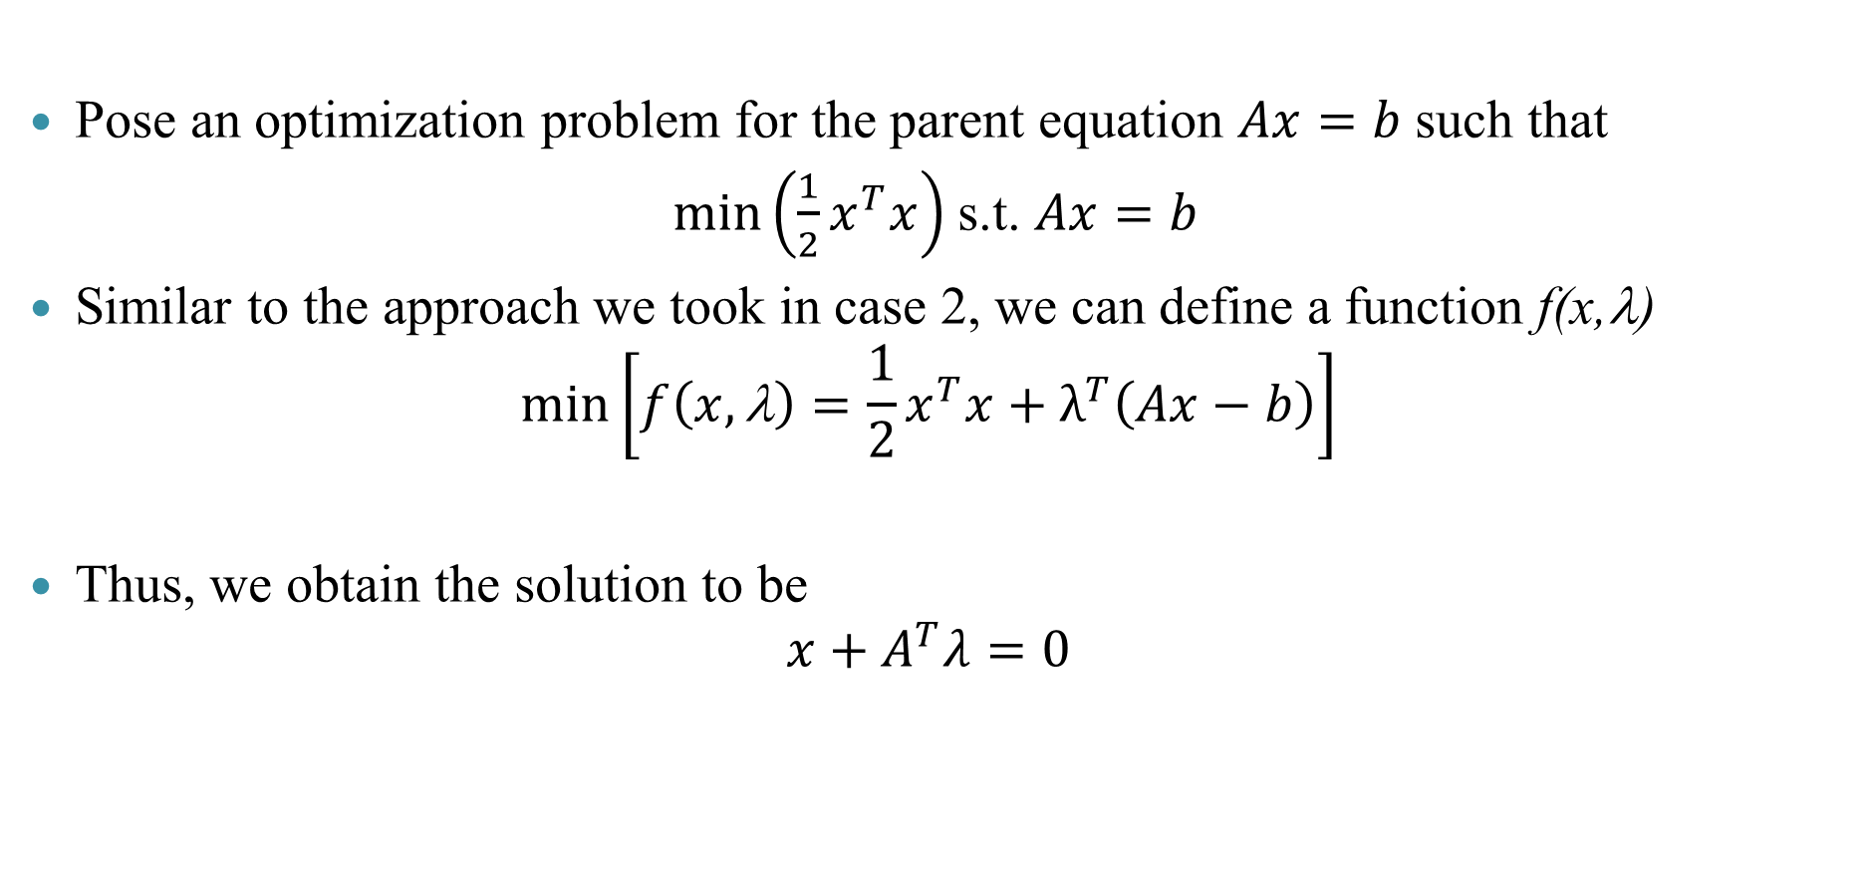
Case 3: An optimization perspective
Pose an optimization problem for the parent equation $Ax=b$such that
$\min\left(\frac{1}{2}x^{T}x\right)$ s.t. $Ax=b$
Similar to the approach we took in case 2, we can define a function f(x,λ)
$$\min\left[f\left(x,\text{l}\right)=\frac{1}{2}x^{T}x+λ^{T}\left(Ax−b\right)\right]$$
Thus, we obtain the solution to be
$$x+A^{T}λ=0$$

Slide 19
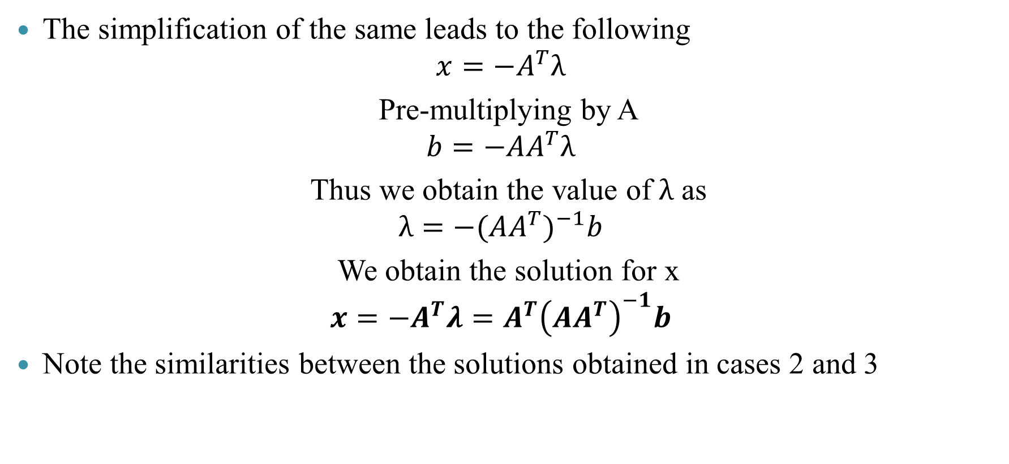
Case 3: An optimization perspective
The simplification of the same leads to the following
$$x=−A^{T}λ$$
Pre-multiplying by A
$$b=−AA^{T}λ$$
Thus we obtain the value of $λ$ as
$$λ=−{(AA^{T})}^{−1}b$$
We obtain the solution for x
$$x=−A^{T}λ=A^{T}{\left(AA^{T}\right)}^{−1}b$$
Note the similarities between the solutions obtained in cases 2 and 3

Slide 20

Case 3: Example
$$\left[\begin{matrix}1 & 2 & 3 \\ 0 & 0 & 1\end{matrix}\right]\left[\begin{aligned}x_{1} \\ x_{2} \\ x_{3}\end{aligned}\right]=\left[\begin{aligned}2 \\ 1\end{aligned}\right]$$
We have the values of A and b.
$m=2,n=3$
Using the optimization concepts,
$$x=A^{T}{\left(AA^{T}\right)}^{−1}b$$
$$x=\left[\begin{matrix}1 & 0 \\ 2 & 0 \\ 3 & 1\end{matrix}\right]{\left(\left\lceil \begin{matrix}1 & 2 & 3 \\ 0 & 0 & 1\end{matrix}\right\rceil \left[\begin{matrix}1 & 0 \\ 2 & 0 \\ 3 & 1\end{matrix}\right]\right)}^{−1}\left[\begin{aligned}2 \\ 1\end{aligned}\right]$$

Slide 21
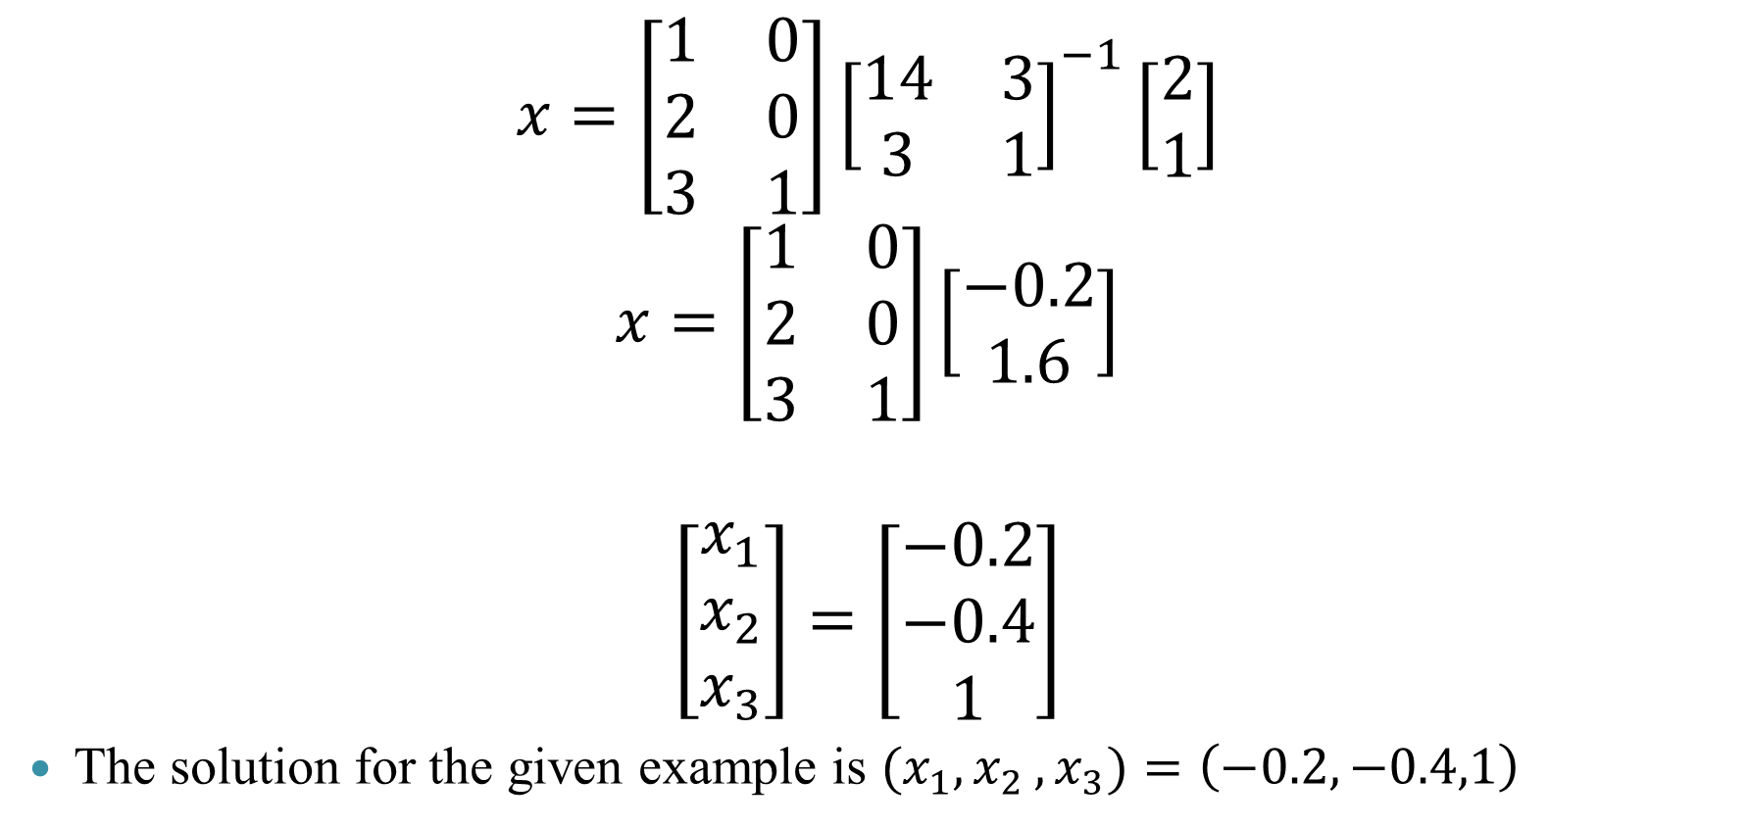
Case 3: Example
$$x=\left[\begin{matrix}1 & 0 \\ 2 & 0 \\ 3 & 1\end{matrix}\right]{\left[\begin{matrix}14 & 3 \\ 3 & 1\end{matrix}\right]}^{−1}\left[\begin{aligned}2 \\ 1\end{aligned}\right]$$
$$x=\left[\begin{matrix}1 & 0 \\ 2 & 0 \\ 3 & 1\end{matrix}\right]\left[\begin{aligned}−0.2 \\ 1.6\end{aligned}\right]$$
$$\left[\begin{aligned}x_{1} \\ x_{2} \\ x_{3}\end{aligned}\right]=\left[\begin{aligned}−0.2 \\ −0.4 \\ 1\end{aligned}\right]$$
The solution for the given example is ${(x}_{1}{,x}_{2},x_{3})=\left(−0.2,−0.4,1\right)$
R Code
A=matrix(c(1,0,2,0,3,1),ncol=3)
b=c(2,1)
library(MASS)
x = t(A)%*%inv(A%*%t(A)) %*%b
x
Console output
A=matrix(c(1,0,2,0,3,1),ncol=3, byrow=F)
b=c(2,1)
x = t(A)%*%inv(A%*%t(A)) %*%b
x

Slide 22
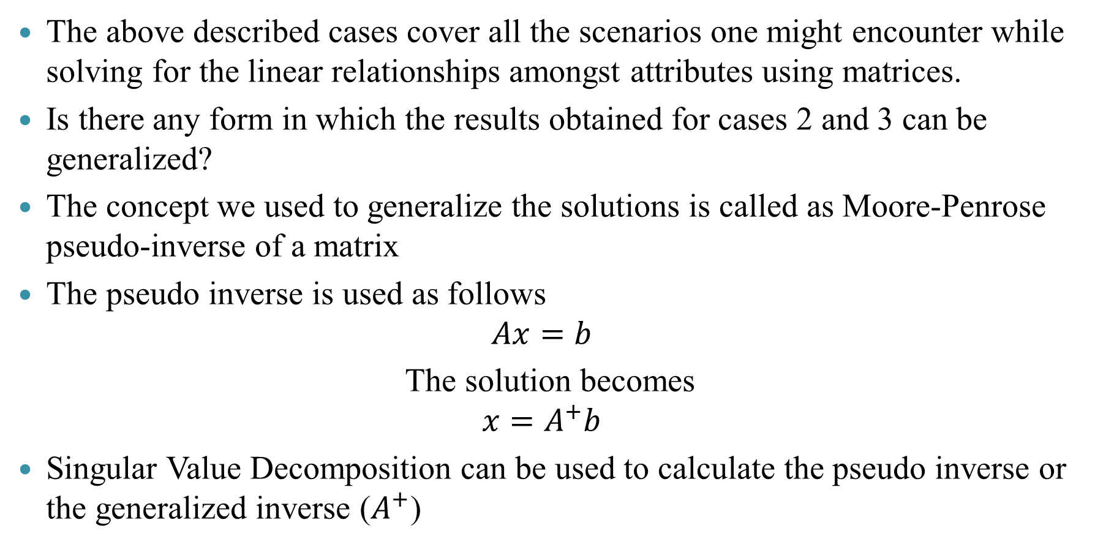
Generalization
The above described cases cover all the scenarios one might encounter while solving for the linear relationships amongst attributes using matrices.
Is there any form in which the results obtained for cases 2 and 3 can be generalized?
The concept we used to generalize the solutions is called as Moore-Penrose pseudo-inverse of a matrix
The pseudo inverse is used as follows
$$Ax=b$$
The solution becomes
$$x=A^{+}b$$
Singular Value Decomposition can be used to calculate the pseudo inverse or the generalized inverse ($A^{+}$)

Slide 23
Two examples revisited
Example 2 Example 3
Solution Solution
R Code
A=matrix(c(1,0,2,0,3,1),ncol=3, byrow=F)
b=c(2,1)
library(MASS)
x = ginv(A)%*%b
R Code
A=matrix(c(1,2,3,0,0,1),ncol=2, byrow=F)
b=matrix(c(1,2,5),ncol=1, byrow=F)
library(MASS)
x= ginv(A)%*%b
> x
[,1]
[1,] -0.2
[2,] -0.4
[3,] 1.0
> x [,1] [1,] 1 [2,] 2

Slide 24
Summary
$$Ax=b$$
𝐴𝑥=𝑏
$$m=n$$
𝑚=𝑛
A is full rank and $\left|A\right|≠0$
A is full rank and |𝐴|≠0
$$m>n$$
𝑚>𝑛
$$m<n$$
𝑚<𝑛
A is not full rank
$x=A^{−1}b$
Unique Solution
𝑥=𝐴^(−1) 𝑏
Unique Solution
Inconsistent
$$(no solution)$$
Inconsistent
(𝑛𝑜 𝑠𝑜𝑙𝑢𝑡𝑖𝑜𝑛)
Consistent
$$(∞ solutions)$$
Consistent
(∞ 𝑠𝑜𝑙𝑢𝑡𝑖𝑜𝑛𝑠)
$$x=A^{+}b$$
𝑥=𝐴^+ 𝑏
$$x=A^{+}b$$
𝑥=𝐴^+ 𝑏
Where we define pseudo inverse $A^{+} appropriately$

